Slide 1
Golang Practice on OSRM
Jay Zhang - Jan 2020

Slide 2
Agenda
Why Golang
Golang on Telenav OSRM
Highlight Golang Features
Conclusion
References

Slide 3
Why Golang

Slide 4
History
Go, also known as Golang
was designed at Google in 2007 by Robert Griesemer, Rob Pike, and Ken Thompson
to improve programming productivity in an era of multicore, networked machines and large codebases.
was publicly announced in November 2009.
version 1.0 was released in March 2012.

Slide 5
Design
The designers wanted to address criticism of other languages in use at Google, but keep their useful characteristics:
Static typing and run-time efficiency (like C++)
Readability and usability (like Python or JavaScript)
High-performance networking and multiprocessing
The designers were primarily motivated by their shared dislike of C++..

Slide 6
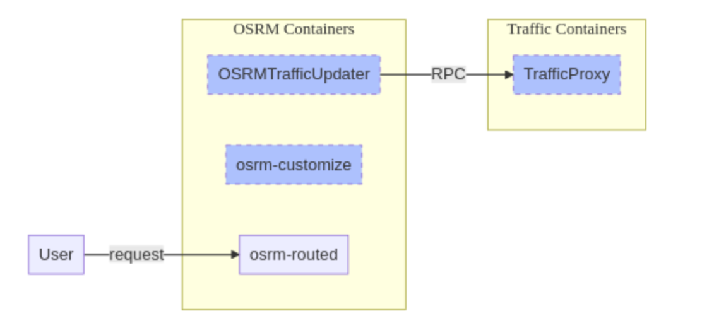
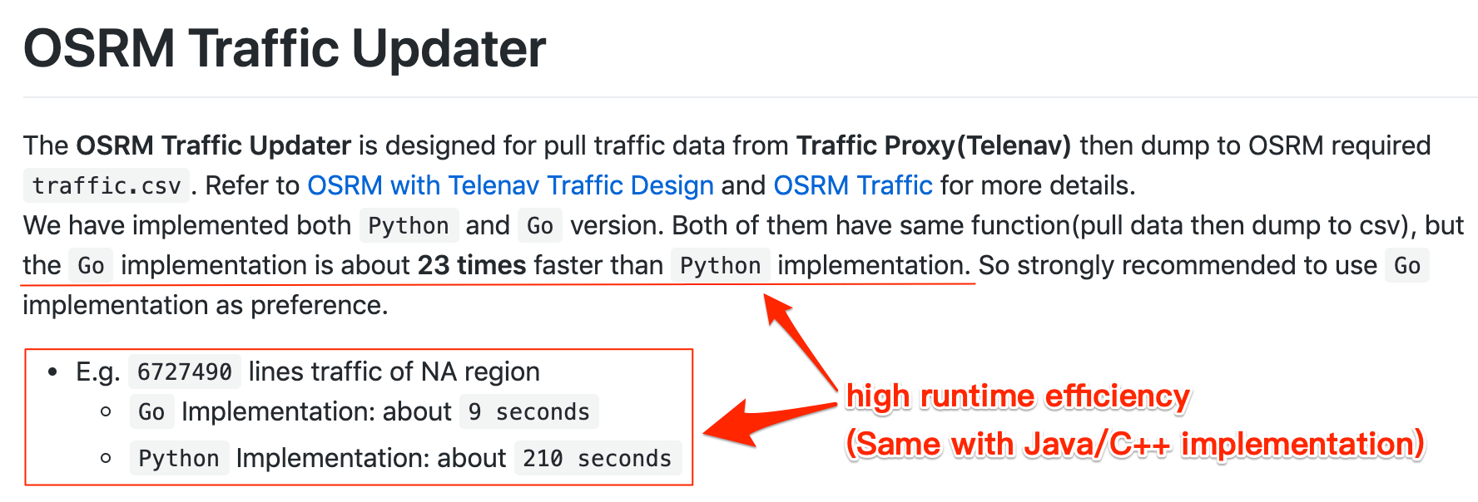
High runtime efficiency

Slide 7
High development efficiency
Develop the ’pull traffic data from trafficproxy via RPC’ time spent
(part of OSRM Traffic Updater, based on thrift)
 | Time spent | Comments
Python | Half day
Golang | Half day
C++ | 3~5 days | Install RPC dependencies in dev/running env(docker) Fix compile and link issues More stuff need to be care, e.g. memory

Slide 8
Widely used
Docker
Kubernetes
Etcd: distributed reliable key-value store
Istio: connect, secure, control, and observe services
Google
Tesla
Mapbox
Uber
Vector Tile Server: https://github.com/go-spatial/tegola
PBF decoder: https://godoc.org/github.com/qedus/osmpbf

Slide 9
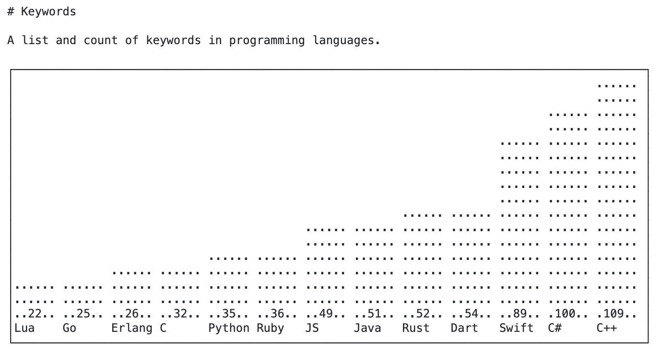
Easy to Learn
Syntax is small compared to other languages
Easy and clear documentation
https://github.com/leighmcculloch/keywords

Slide 10
More Articles
Why Go
https://github.com/golang/go/wiki/WhyGo
Companies currently using Go throughout the world
https://github.com/golang/go/wiki/GoUsers
Success Stories
https://github.com/golang/go/wiki/SuccessStories

Slide 11
Golang on Telenav OSRM

Slide 12
Repos
OSRM Integration:
https://github.com/Telenav/osrm-backend/tree/master-telenav/integration

Slide 13
Statistics
 | Files | Code | Comments | Blank | Total
Golang Codes | 128 | 7451 | 524 | 1468 | 9443
More than 1/3 test codes.

Slide 14
Created Micro Services
cmd/osrm-ranking | Update duration/weight by traffic for many alternatives, then pick up best as result.
cmd/directionadapter | Designed for providing unified services interface and hide the actual direction engines in behind, e.g. OSRM, NGX_Cloud, Valhalla, etc. Also more features, e.g. playback OSRM route on NGX_Cloud, Detour service, etc.

Slide 15
Created Command Line Tools
cmd/wayid2nodeid-extractor | Command line tool for extract wayid to nodeids mapping from PBF.
cmd/snappy | Command line tool for snappy compression.
cmd/osrm-traffic-updater | Designed for pull traffic data from traffic-proxy(Telenav) then dump to OSRM required traffic.csv for osrm-customize.
cmd/trafficproxy-cli | Command line tool for querying traffic from trafficproxy.
cmd/trafficcache-parallel-test | Command line tool for traffic cache test, i.e. test caches(indexed by wayID and indexed by Edge) in parallel.
cmd/osrm-files-extractor | Command line tool for extract and show information of OSRM generated .osrm[.*] files.

Slide 16
More Plan
Oasis - Optimized Charge Station Selection Service (#120, #121)
Preprocessing PBF before OSRM (#110)
Backend service of Visualized OSRM Debugging Tool (#111)
New ETA Cloud Service

Slide 17
Highlight Golang Features

Slide 18
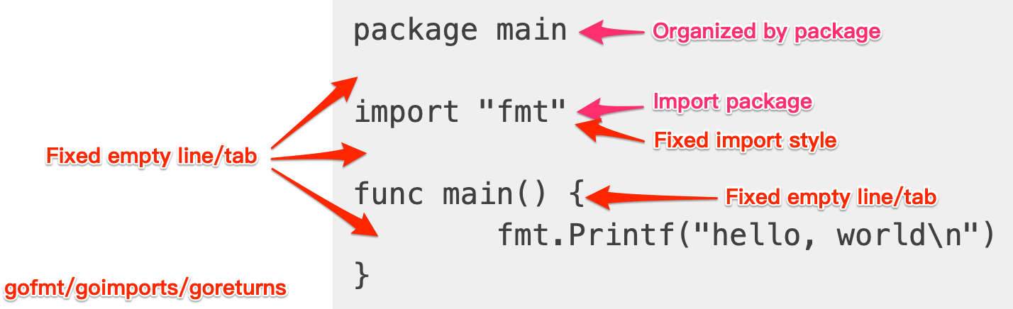
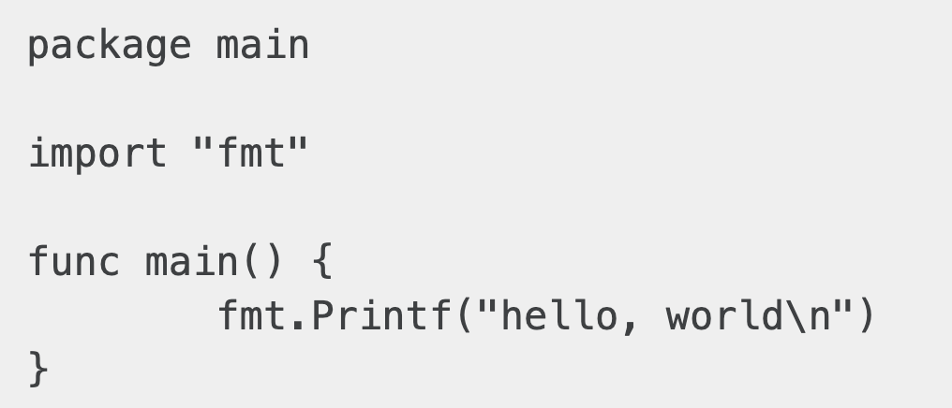
Hello, World

Slide 19
Fast and Efficient Build
No Warning, either PASS or ERROR
E.g. unused local variable → ERROR
E.g. unused import package → ERROR
Static Linking only

Slide 20
No extra runtime dependency
Single standalone executable binary contains everything it needs
Underlying requires libc only

Slide 21
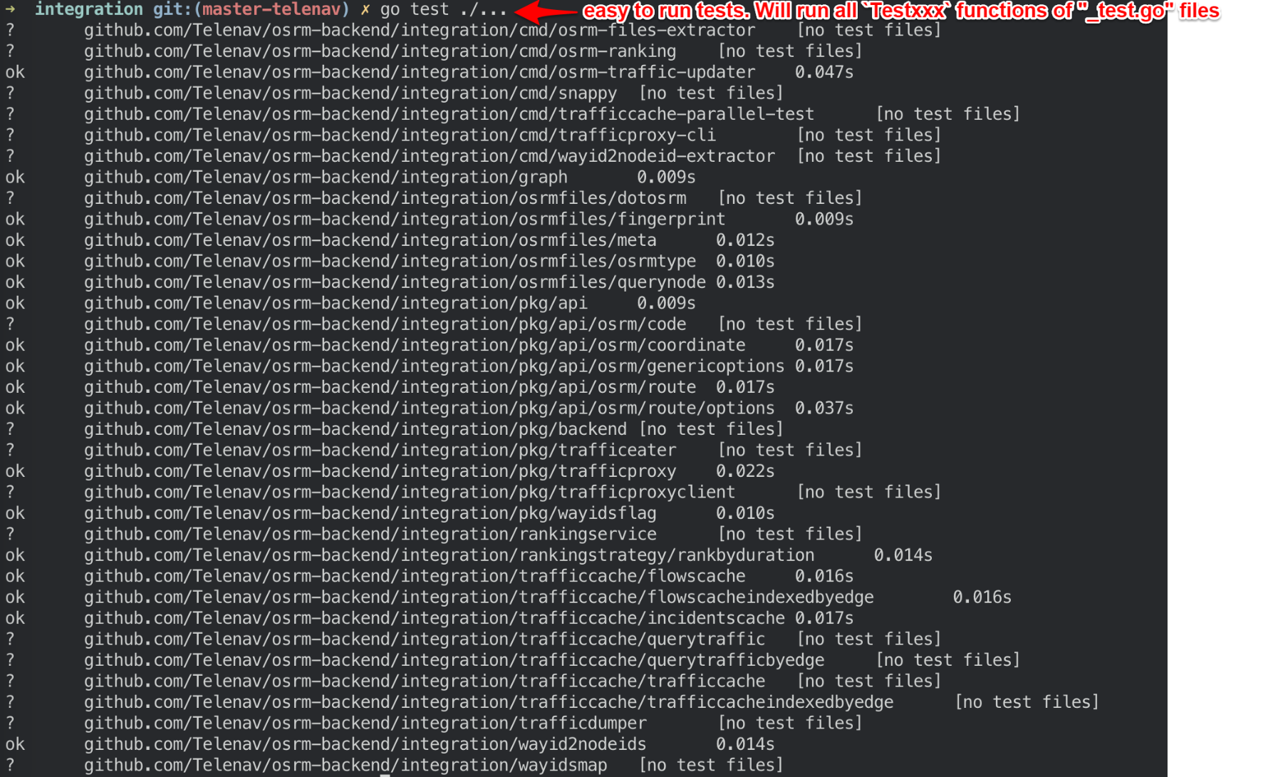
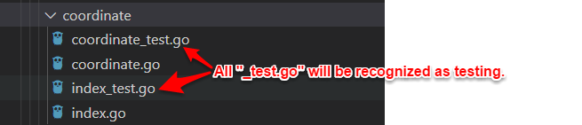
Go test
Unit test
Benchmark
Coverage
CPU/Block/Mem profile
Race detector

Slide 22
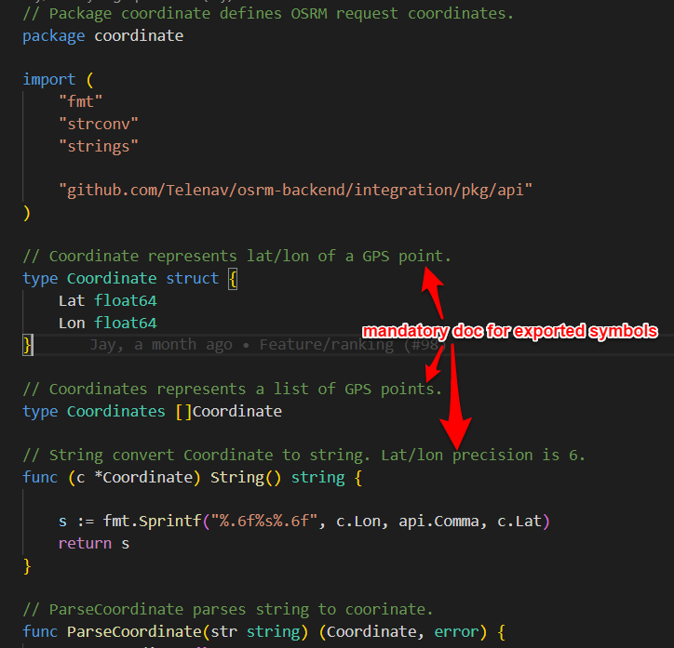
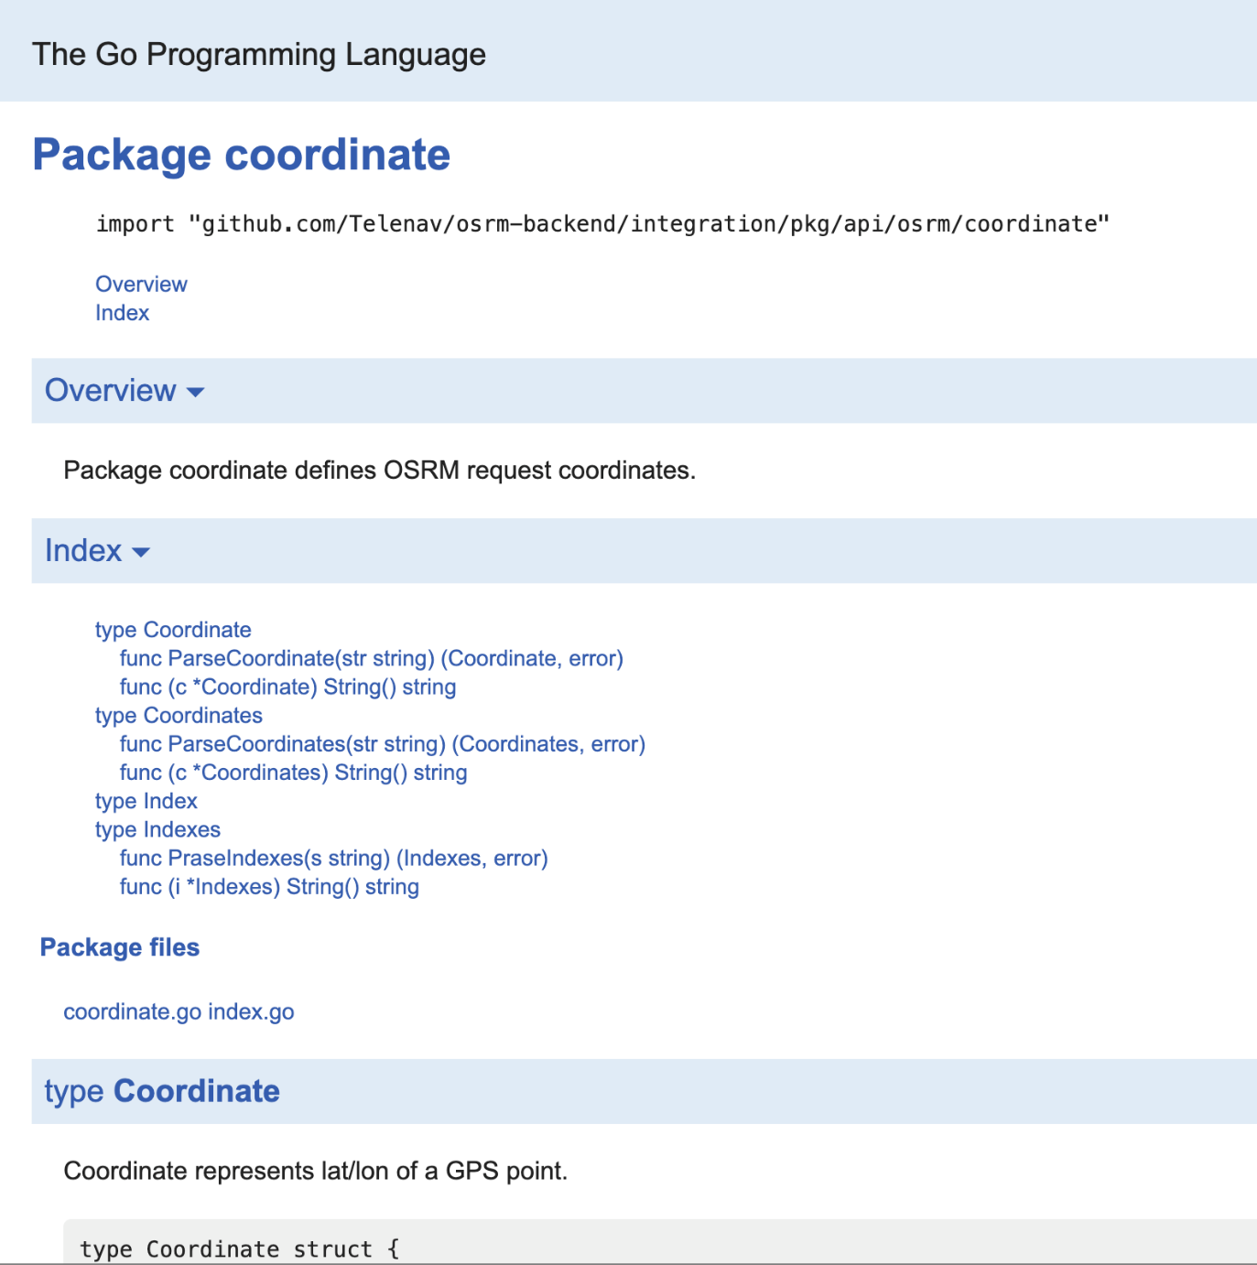
Go doc

Slide 23
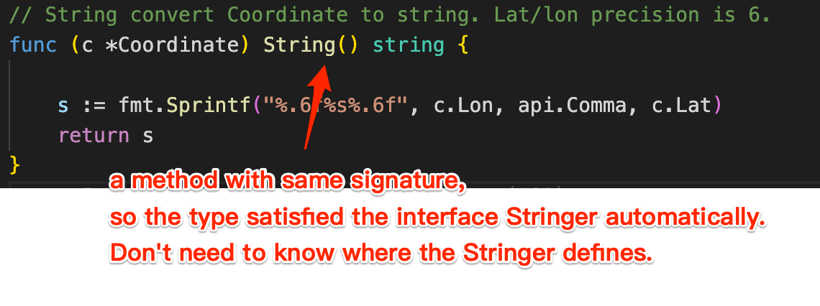
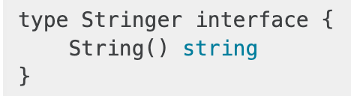
Object-oriented?
No Class
No Inheritance
Type
Struct
Method
Interface
In Go a type automatically satisfies any interface that specifies a subset of its methods.
(declare ahead of time that two types are related)

Slide 24
Memory
Pointer
Garbage collector
Each variable in Go exists as long as there are references to it
Automatically allocate on heap or stack
Always pass by value(i.e. No reference)

Slide 25
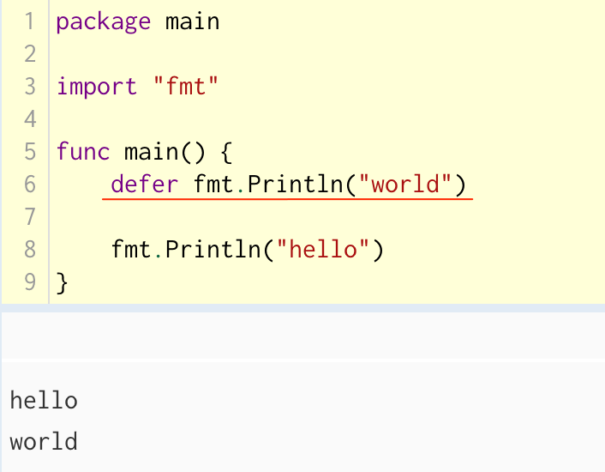
Defer

Slide 26
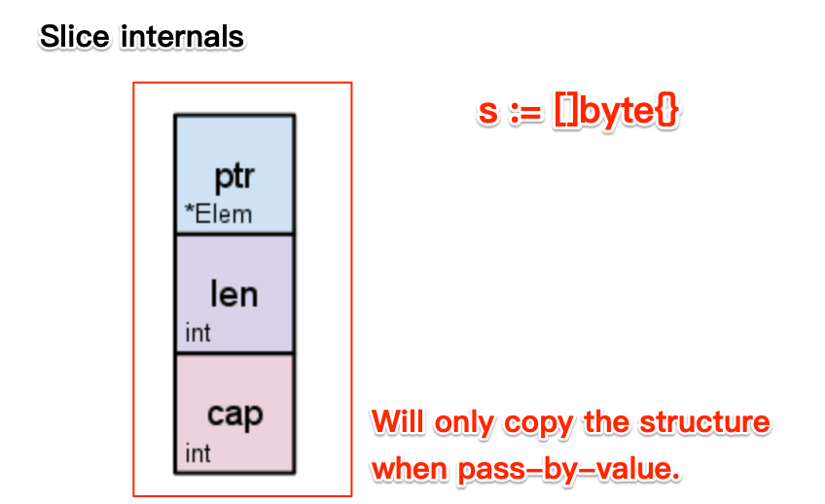
Powerful internal types
Slice ~ std::vector
Map ~ std::unordered_map

Slide 27
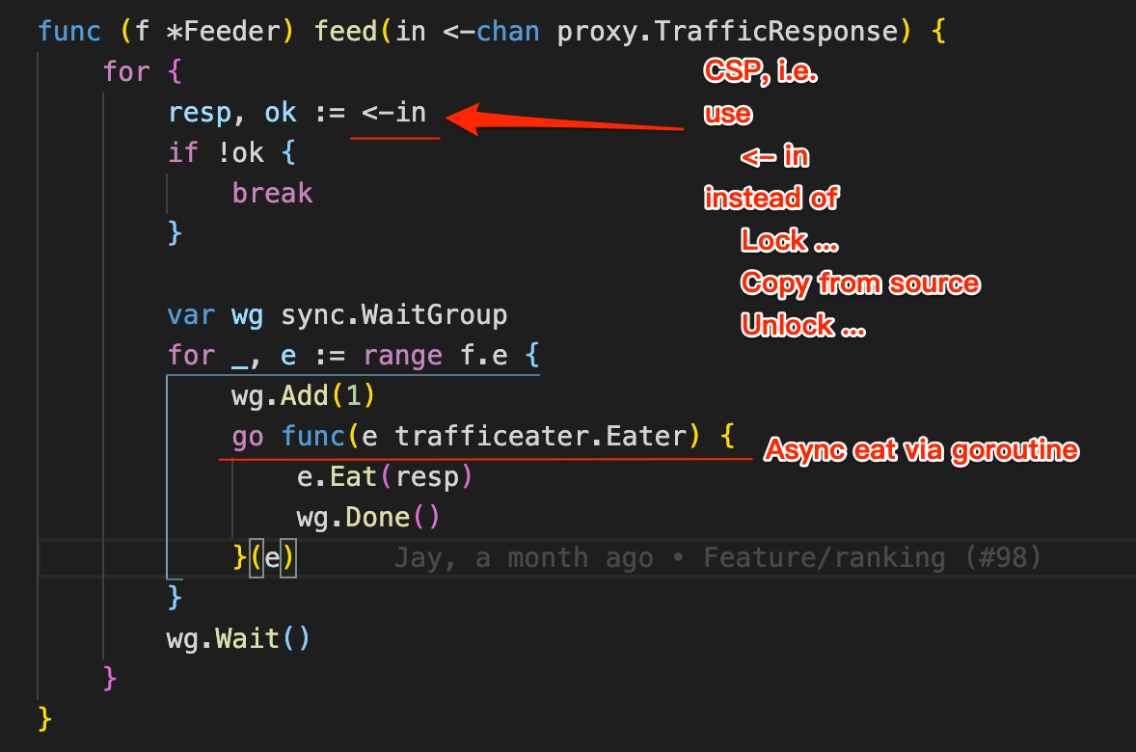
Concurrency
CSP: Communicating Sequential Processes
Do not communicate by sharing memory;
instead, share memory by communicating.
Goroutine
M:N scheduling
No ID
Dynamic Stack
Channel

Slide 28
Conclusion

Slide 29
It’s good for
Cloud service
Cross-platform command line tools(Win, Mac, Linux)
E.g. data processing, various of test purpose tools, etc.

Slide 30
It’s NOT good for
If want to operate hardware directly or control performance/memory accurately
E.g. embedded development
GUI

Slide 31
References

Slide 32
Learning Resources
https://golang.org/
A Tour of Go: https://tour.golang.org/
How to write Go Code: https://golang.org/doc/code.html
Doc: https://golang.org/doc/
FAQ: https://golang.org/doc/faq
Blog: https://blog.golang.org/

Slide 33
Learning Resources - Books
The Go Programming Language: https://www.gopl.io/
Effective Go: https://golang.org/doc/effective_go.html
Go语言学习笔记
https://github.com/qyuhen/book
https://book.douban.com/subject/26832468/

Slide 34
Thanks!

